Slide 1
PCF Metrics and PCF Healthwatch
Cory Jett, Platform Architect
April, 2018

Slide 2
Why use PCF Metrics?
Developer Productivity
Enables app observability just by cf push
Correlated & unified view of metrics, logs, events, tracing & alerts
Multi tenancy enabled by UAA
Spring Boot monitoring and troubleshooting
Operational efficiency
One click, minimal config tile install
Configurable data retention from 1 day to 2 weeks
Configurable sizing options ( dev, staging, prod)
Replacing ES with PostgreSQL to improve stability and reduce the total VM resource footprint down to 3 VMs
Free with Platform subscription

Slide 3
What features PCF Metrics does provide?
Metrics
HTTP Metrics: response time, throughput, error requests
Container resource metrics: CPU, Memory, Disk % usage
Custom Metrics ( For Spring boot, these are actuator metrics)
Logs
Keyword filter and highlight, Histogram, Download
Tracing
Response time distribution for all requests within single trace along with correlated logs

Slide 4
What features PCF Metrics does provide?
Events
App crash, start, stop, update, staging fail, SSH
Alerts
Setup monitors for metrics, events
Support for webhook notifications
Dashboard
Unified view of metrics, logs, alerts and events upto 2 weeks
Filter metrics by application instances
Simple time slider for macro time navigation
Drag and zoom on graphs for finer grain time navigation

Slide 5
How does it fit in with APM Partners?
Only Overlap
Custom metrics (For spring boot, they are JVM, HTTP route metrics)
PCF Metrics use cases
Pre-prod performance testing, troubleshooting
Spring boot apps monitoring and troubleshooting
App crash troubleshooting
APM use cases
Code level troubleshooting insights
Monitoring non-PCF Workloads
More than two weeks data retention
Dev familiarity with existing tooling

Slide 6
PCF Metrics quickstart and Roadmap
Getting started
https://github.com/pivotal-cf/pcf-metrics-trace-example-spring
Getting started guide and Product videos - Coming soon
Validated roadmap features
Support tagged metrics (Micrometer support)
Multi-apps health dashboard
Roadmap features that need discovery and definition
Services metrics integration
Multi-foundation support
Integrating Hystrix metrics
Roadmap Details in aha
Add your requests in Ideas section aha

Slide 7
Our Journey so far….
Optimized for spring boot monitoring, troubleshooting on PCF
Alerting,
Live Streaming
3 VMs
Custom metrics,
Instance metrics,
Config sizing
7 VMs
Distributed tracing with correlated logs,
14 VMs
1.5
Q1 18
Re-arch backend,
2 weeks,
14 VMs
1.4
Q4 17
Integrated logs,
24 hours,
26 VMs
App metrics events,
24 hours,
22 VMs
1.3
Q1 17
1.2
Q4 16
1.1
Q3 16
1.0
Q2 16

Slide 8
PCF v2.1
HealthWatch 1.2
Events & Alerting
Alerting. KPI/KSI out of the box Alerts with configuration of shipped thresholds
Isolation Segments. Handling impacts to Healthwatch super-metrics produced; Impacts to Healthwatch UI
Data. Data Store & Data Aggregation Improvements
Eliminate creation of service network requirement for production installation.
PCF Healthwatch publishes events. Subscribers can receive messages (email, Slack, webhook) on KPI thresholds in Healthwatch.
Configure Event Alerts is via a CF CLI plugin.
Example: Healthwatch publishes a warning event when BOSH system memory is greater than 80% and a critical event when greater than 90% link to Healthwatch docs, Platform operators can now subscribe to Healthwatch’s system.mem.percent topic and receive warning and critical messages via email, Slack or webhook integration when these events occur.
To be released
Notes:
https://pcf.aha.io/products/PMON/feature_cards

Slide 9
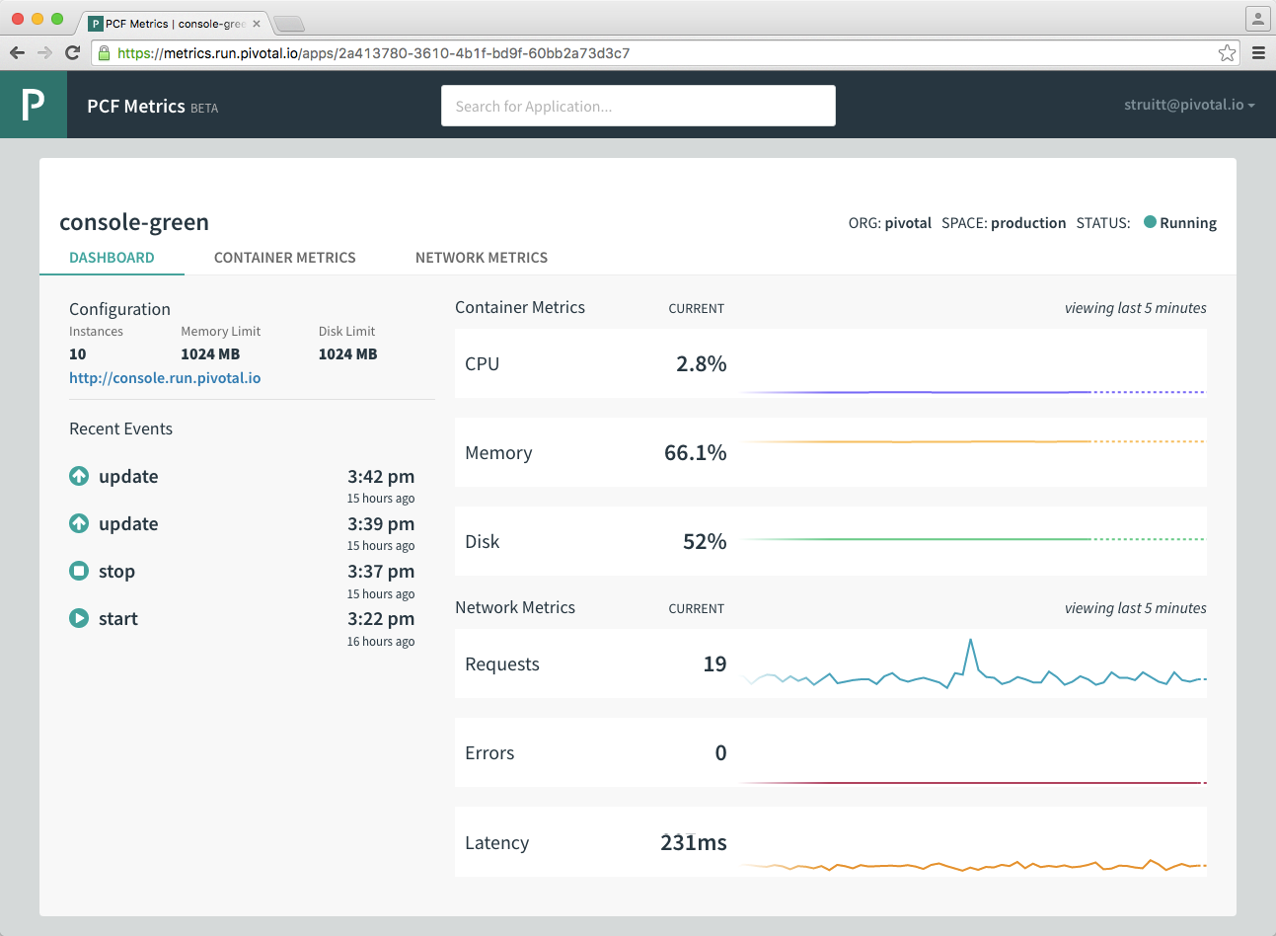
PCF Metrics provides fast-feedback App Monitoring
Integrated, near real-time view of key app, services & platform metrics
Devs & Ops have shared understanding of system health / availability
No embedded agent
Simply select an app to watch streaming data
Alerts on app metrics
Notes:
TODO

Slide 10
PCF HealthWatch 1.2
Alerting. KPI/KSI out of the box Alerts with configuration of shipped thresholds
Isolation Segments. Handling impacts to Healthwatch super-metrics produced; Impacts to Healthwatch UI
Data. Data Store & Data Aggregation Improvements
Eliminate creation of service network requirement for production installation.
Adapts for PCF 2.1 relevant KPI/KSI changes
ICYMI: 1.1 Features
Support for SFP
Custom Foundation Label for published metrics
Cross-Browser Support
Custom Foundation Label displays on dashboard
Minor UI/UX Improvements
Release Target: March 2018
Operator Efficiency
Notes:
https://pcf.aha.io/products/PMON/feature_cards

Slide 11
Events & Alerting (EVA)
PCF Healthwatch publishes events.
With EVA, subscribers can receive messages (email, Slack, webhook) on KPI thresholds in Healthwatch.
Configure Event Alerts is via a CF CLI plugin.
Example:
Healthwatch publishes a warning event when BOSH system memory is greater than 80% and a critical event when greater than 90% link to Healthwatch docs, Platform operators can now subscribe to Healthwatch’s system.mem.percent topic and receive warning and critical messages via email, Slack or webhook integration when these events occur.
Release Target: March 2018
Operator Efficiency

Slide 12
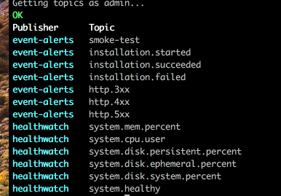
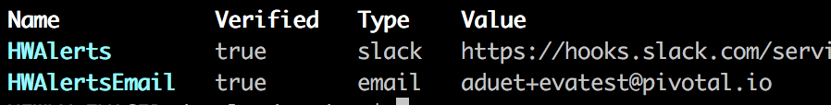
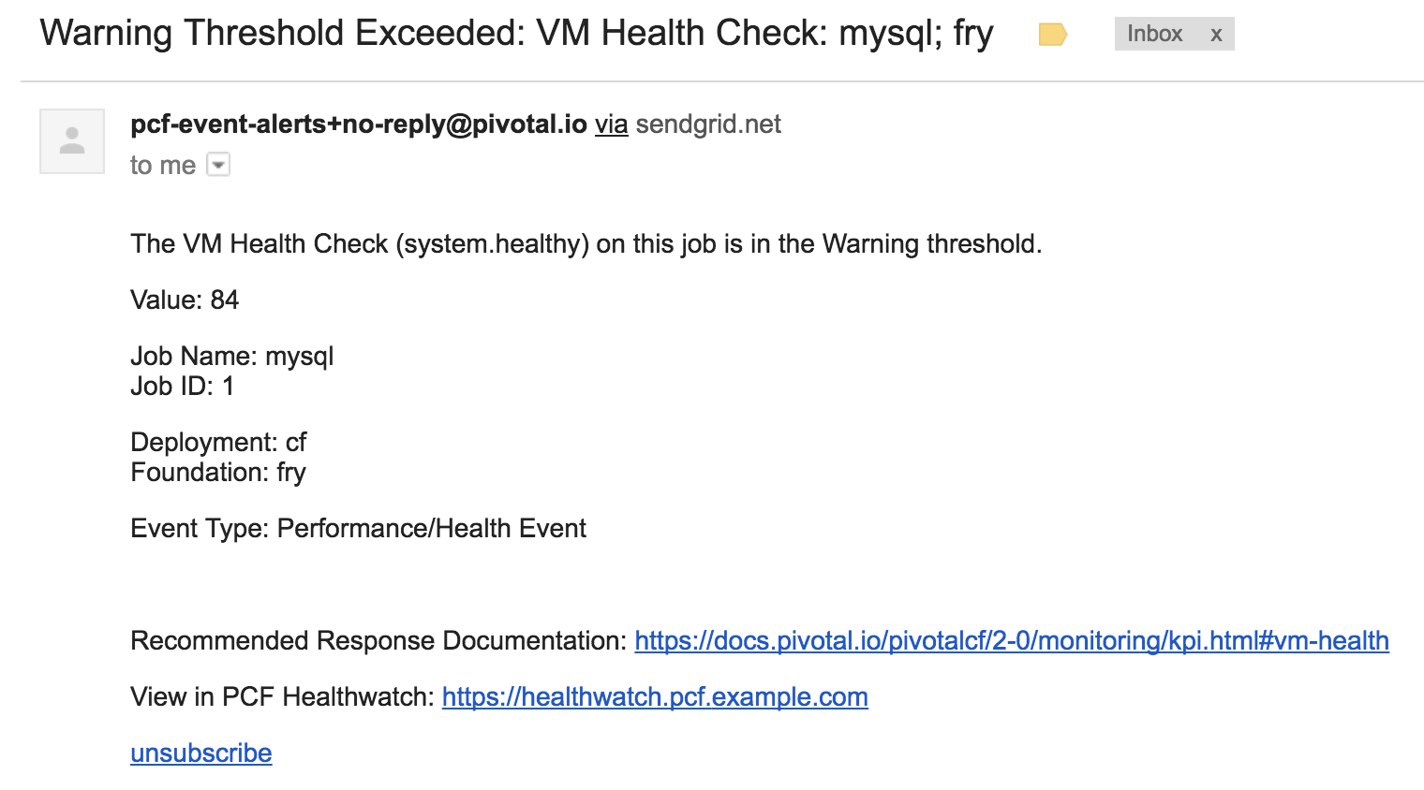
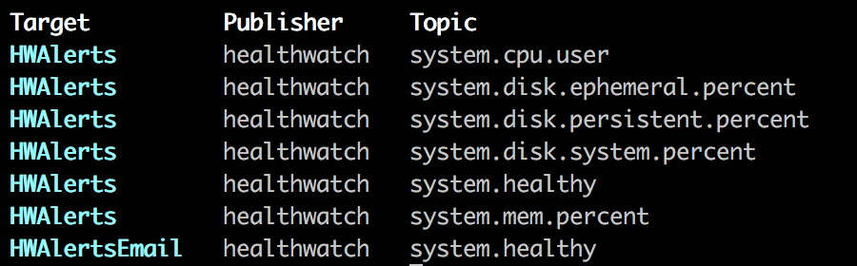
Events & Alerting
Create slack, email or webhook targets
View available topics
Subscribe a target to topics
Receive events

Slide 13
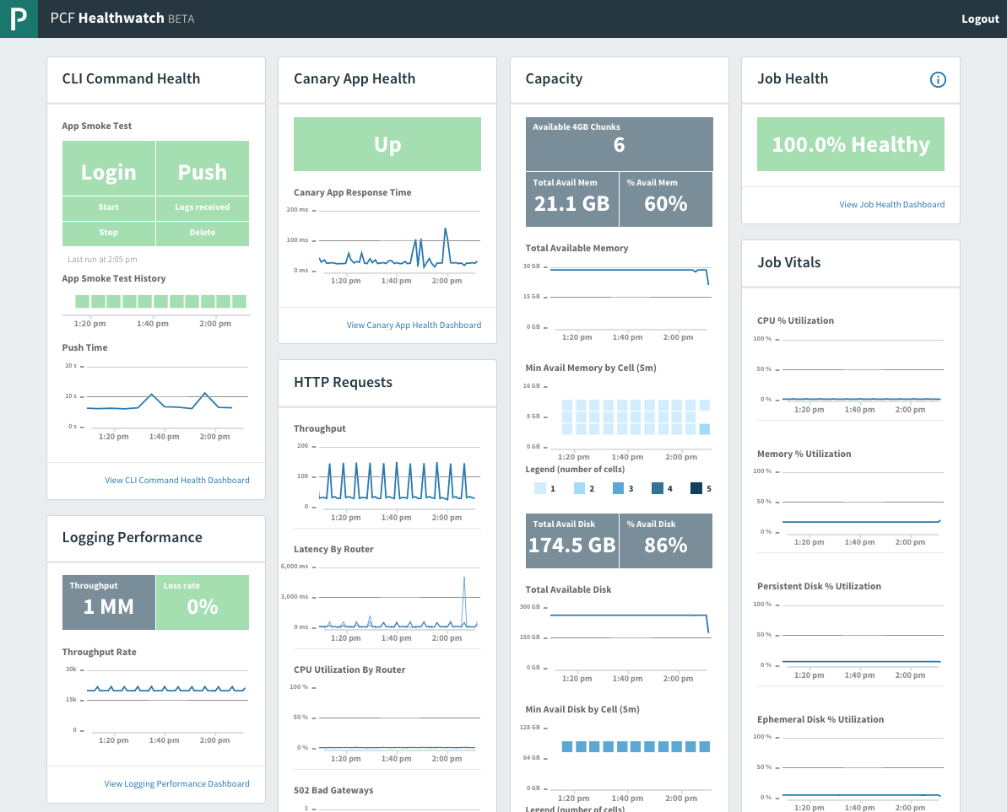
PCF Healthwatch
An operational dashboard for PCF. The product monitors and displays important data about the platform’s performance.
Notes:
PCF Healthwatch provides operations with an operational dashboard and simple pane of glass to monitor the vital signs of Pivotal Cloud Foundry.
PCF Healthwatch provides coverage of the recommended Key Performance Indicators and Key Scaling Indications for a given version of PCF. Associated data is retained for 25 hours.
Healthwatch Executes recommended operational health checks as continuous validation tests.
It also stores and displays the results of the checks as well as forwards this data into the Loggregator Firehose for external consumption by existing customer solutions.

Slide 14

Transforming How The World Builds Software
© Copyright 2017 Pivotal Software, Inc. All rights Reserved.

Slide 15

WE build the container
YOU build the container
Application Code & Frameworks
Buildpacks | Spring Boot | Spring Cloud | Steeltoe
Continuous
delivery
Github
Public Cloud Services
Pivotal Network
Open Service Broker API
Pivotal Application Service (PAS)
Pivotal Container Service (PKS)
Pivotal Services Marketplace
Customer Managed Services
Concourse
>cf push
>kubectl run
Pivotal and
Partner Products
v1
CVEs
Product Updates
Java | .NET | NodeJS
Elastic | Packaged Software | Spark
v2
“3Rs”
v3
Embedded OS
(Windows & Linux)
NSX-T
Repair
— CVEs
Repave
Rotate
— Credhub
...
Concourse
CPI (15 methods)
vSphere
Openstack
AWS
Google Cloud
Azure & Azure Stack

